Slide 1
Shoreline Clean-up Techniques
CGPRT(W) : Ensuring Clean Seas and Coasts in Western Region ……

Slide 2
Objective
To understand the operational aspects of shoreline clean-up techniques.
CGPRT(W) : Ensuring Clean Seas and Coasts in Western Region ……

Slide 3
Aim
Recovery at sea is first priority because:
Less potential for ecological, socio-economic and cultural impacts in open waters
Shoreline clean-up is logistically more complex than oil recovery at sea
Costs increase dramatically when oil reaches shorelines
However, most oil spills reach the shoreline and cause visible pollution
CGPRT(W) : Ensuring Clean Seas and Coasts in Western Region ……

Slide 4
Overall Objective of Shoreline Clean-up
Remove the oil or accelerate the natural recovery.
The selection and correct application of clean-up techniques are therefore essential.
Information generated by the SCAT survey(s) is a basic component of the decision process for setting response priorities, clean-up objectives and acceptable levels of treatment.
CGPRT(W) : Ensuring Clean Seas and Coasts in Western Region ……

Slide 5
Shoreline Clean-up
Treatment standards (“end-points”) are based on:
An accurate knowledge of the initial oiling conditions;
The character of the stranded oil that is provided by the SCAT survey.
The decision to end the treatment should be based on goals or levels of effort established before the operation begins.
CGPRT(W) : Ensuring Clean Seas and Coasts in Western Region ……

Slide 6
Factors Affecting Shoreline Clean-up
Oil quantity
Oil characteristics:
toxicity; viscosity
Prevailing on-site conditions:
weather; season; tides; temperature; accessibility
Shoreline type
CGPRT(W) : Ensuring Clean Seas and Coasts in Western Region ……

Slide 7
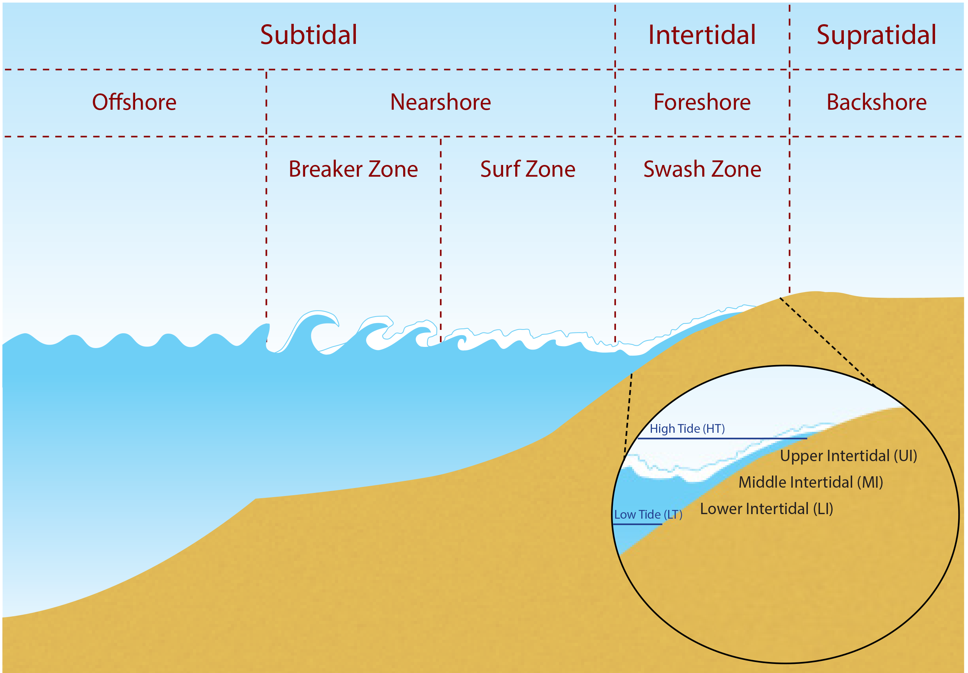
Cross-Section of Beach Showing Shoreline Areas
Source: OSRL
CGPRT(W) : Ensuring Clean Seas and Coasts in Western Region ……

Slide 8
Stages of Shoreline Clean-up
Normally not an emergency – a project lasting weeks, months, years.
Stage 1. Removal of gross pollution and bulk oil
Stage 2. Removal of remaining stranded oil and oiled shoreline materials/debris
Stage 3. Final polishing/aesthetic treatment
CGPRT(W) : Ensuring Clean Seas and Coasts in Western Region ……

Slide 9
NEBA
Net Environmental Benefit Analysis (NEBA)
Aims to decrease the overall effect of oil on the environmental and economic resources whilst achieving an acceptable standard of clean-up
CGPRT(W) : Ensuring Clean Seas and Coasts in Western Region ……

Slide 10
Natural Recovery vs. Response
What is the working environment?
Will response activities accelerate natural recovery or will response activities delay natural recovery?
Are response activities possible from a safety perspective?
CGPRT(W) : Ensuring Clean Seas and Coasts in Western Region ……

Slide 11
Shoreline Treatment Methods
Natural recovery
Physical methods:
Washing
Removal
In situ Treatment
Chemical and biological methods
CGPRT(W) : Ensuring Clean Seas and Coasts in Western Region ……

Slide 12
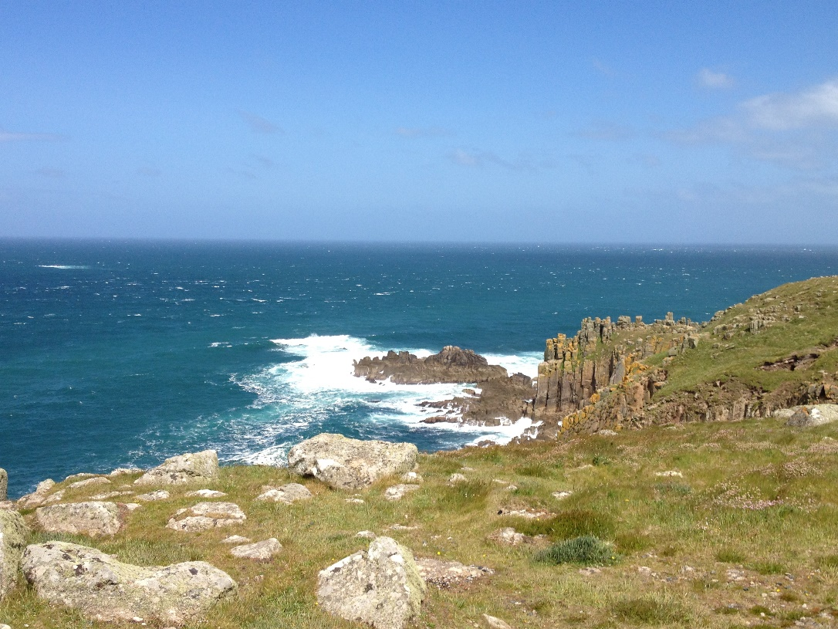
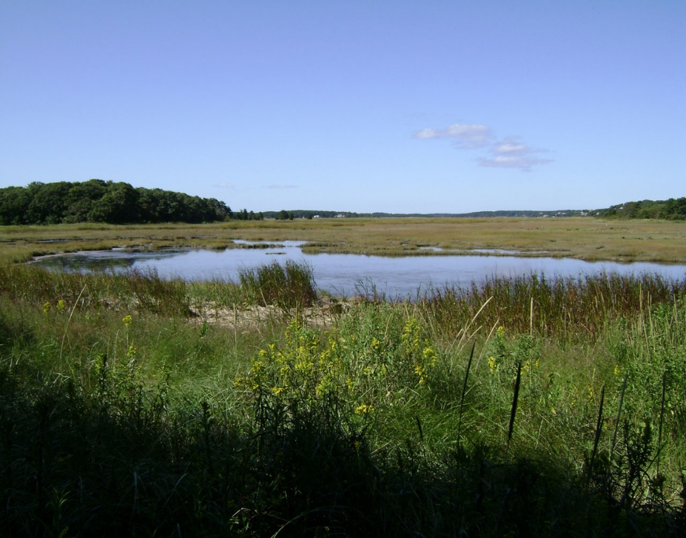
Natural Recovery
Source: OSRL
Source: OSRL
High energy shoreline
Low energy shoreline
CGPRT(W) : Ensuring Clean Seas and Coasts in Western Region ……

Slide 13
Physical Techniques − Washing
This group of methods involves a variety of washing or flushing techniques that can be used to move oil from the shore zone to a location for collection.
Flooding
Low-pressure washing
High-pressure washing
CGPRT(W) : Ensuring Clean Seas and Coasts in Western Region ……

Slide 14
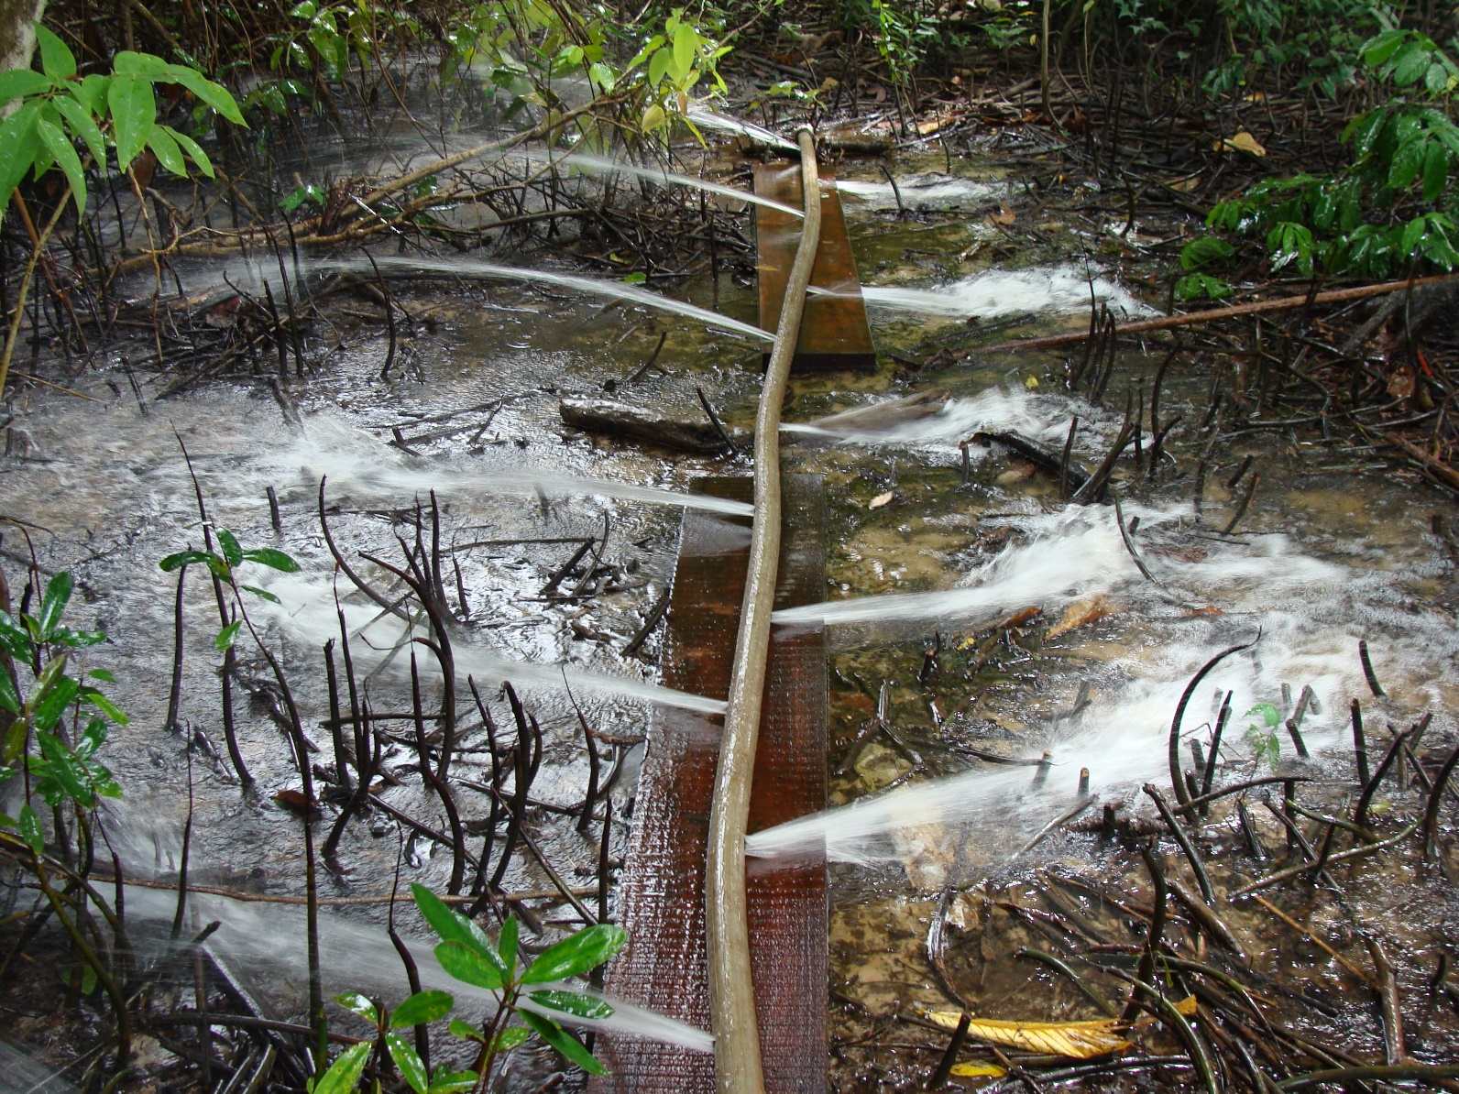
Flooding
Source: OSRL
CGPRT(W) : Ensuring Clean Seas and Coasts in Western Region ……

Slide 15
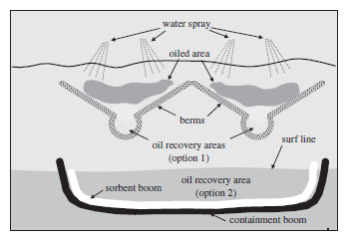
Low-Pressure Washing
Source: ExxonMobil
CGPRT(W) : Ensuring Clean Seas and Coasts in Western Region ……

Slide 16
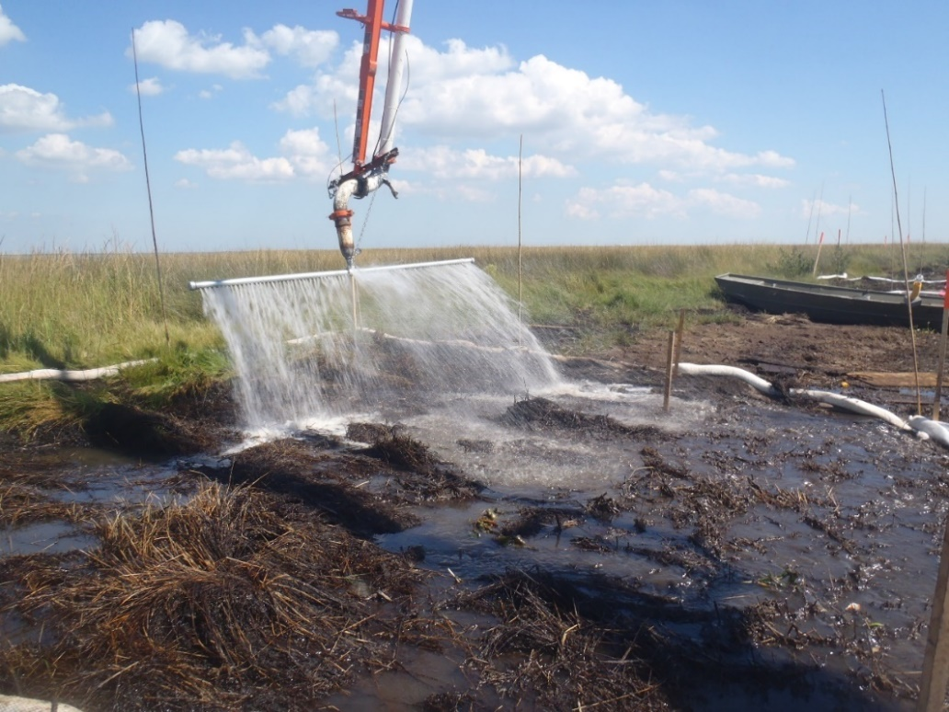
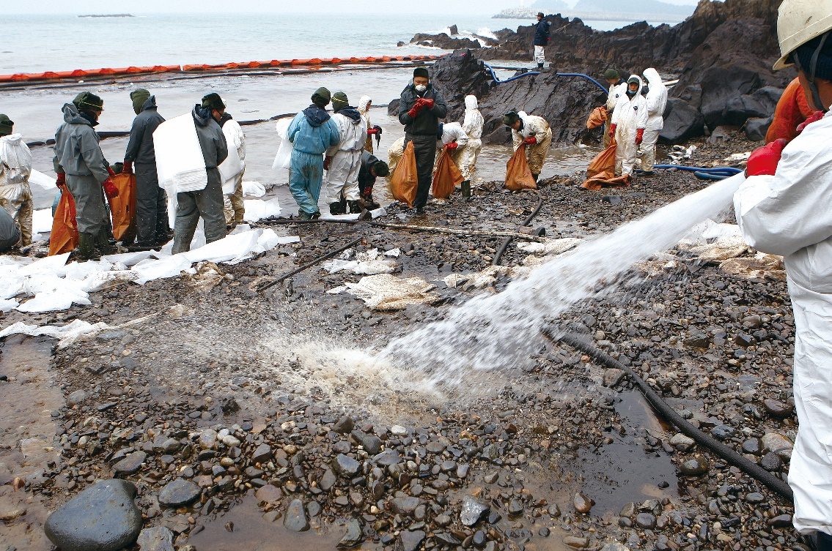
Low-Pressure Washing
Source: OSRL
Source: Korea Coast Guard
CGPRT(W) : Ensuring Clean Seas and Coasts in Western Region ……

Slide 17
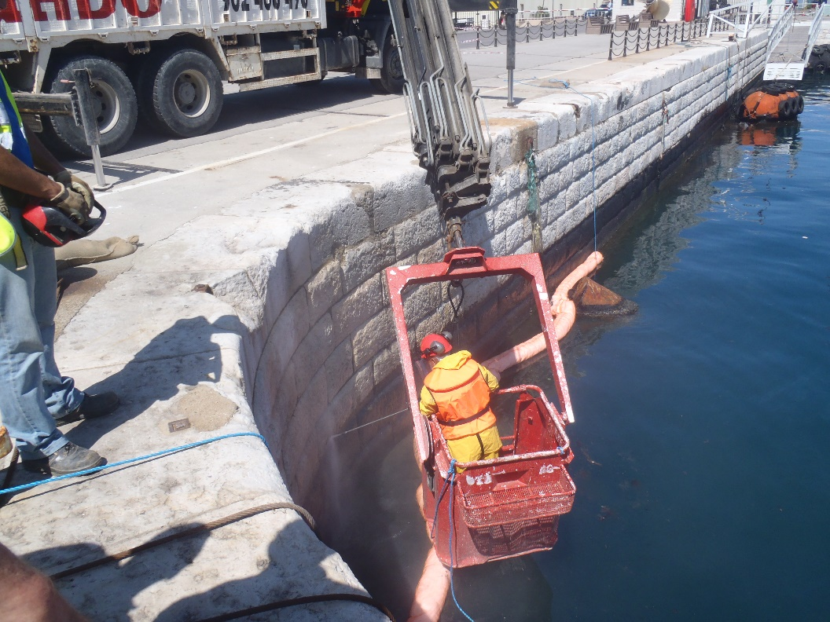
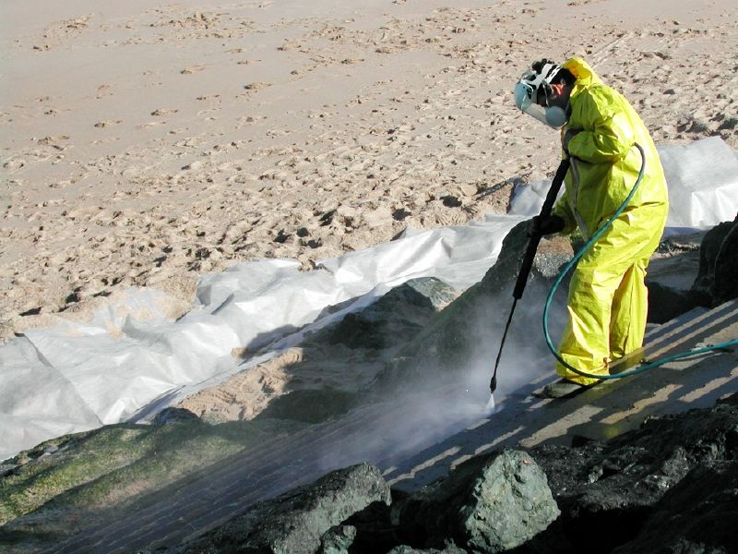
High Pressure Washing
Source: OSRL
Source: CEDRE
CGPRT(W) : Ensuring Clean Seas and Coasts in Western Region ……

Slide 18
Technique | Objective | Optimum use
Flooding | Flood a site so that mobile oil is lifted and carried downslope to a collection area | Most shoreline types Light to medium oils
Low-pressure, cold wash | Wash or flush oils toward a collection area using ambient sea, lake or river water at low pressure | Impermeable shorelines and marsh Light to medium oils
Low-pressure, warm/hot wash | Wash or flush oils at low pressure, using heated water, toward a collection area | Impermeable shorelines Light to medium oils
High-pressure, cold wash | Wash or flush oils toward a collection area using ambient sea, lake or river water at high pressure | Impermeable shorelines medium to heavy oils
High-pressure, warm/hot wash | Wash or flush oils at high pressure, using heated water, toward a collection area | Impermeable shorelines medium to heavy oils
Steam cleaning | Remove stains or dislodge thin layers of viscous oil from hard surface | Impermeable man-made structures Stains or heavy, weathered oils
CGPRT(W) : Ensuring Clean Seas and Coasts in Western Region ……

Slide 19
Operational Considerations
Washing oil and/or sediments downslope into the lower intertidal zones that have attached plant or animal communities should be avoided (especially if the flora/fauna were not initially oiled).
Can be avoided by working at high tide so oil is collected on water at times when these communities are below the water line.
CGPRT(W) : Ensuring Clean Seas and Coasts in Western Region ……

Slide 20
Operational Considerations
The mobilized or flushed oil and oiled sediment should be contained and collected.
Stranded oil on shorelines should also be contained to prevent contamination of adjacent shorelines by tides.
On marine coasts, only sea water should be used since fresh water can harm intertidal plants and animals.
CGPRT(W) : Ensuring Clean Seas and Coasts in Western Region ……

Slide 21
Operational Considerations
High-pressure water can dislodge/damage attached healthy organisms.
High-pressure action could emulsify the oil.
Extreme low temperatures may result in hoses freezing/formation of ice on shorelines.
CGPRT(W) : Ensuring Clean Seas and Coasts in Western Region ……

Slide 22
Physical Techniques: Removal
This group of physical methods involves removal of the oil or oiled material (sediments, debris, vegetation ) from the shore for disposal.
Manual
Vacuum systems
Mechanical
Vegetation cutting
Passive sorbents
CGPRT(W) : Ensuring Clean Seas and Coasts in Western Region ……

Slide 23
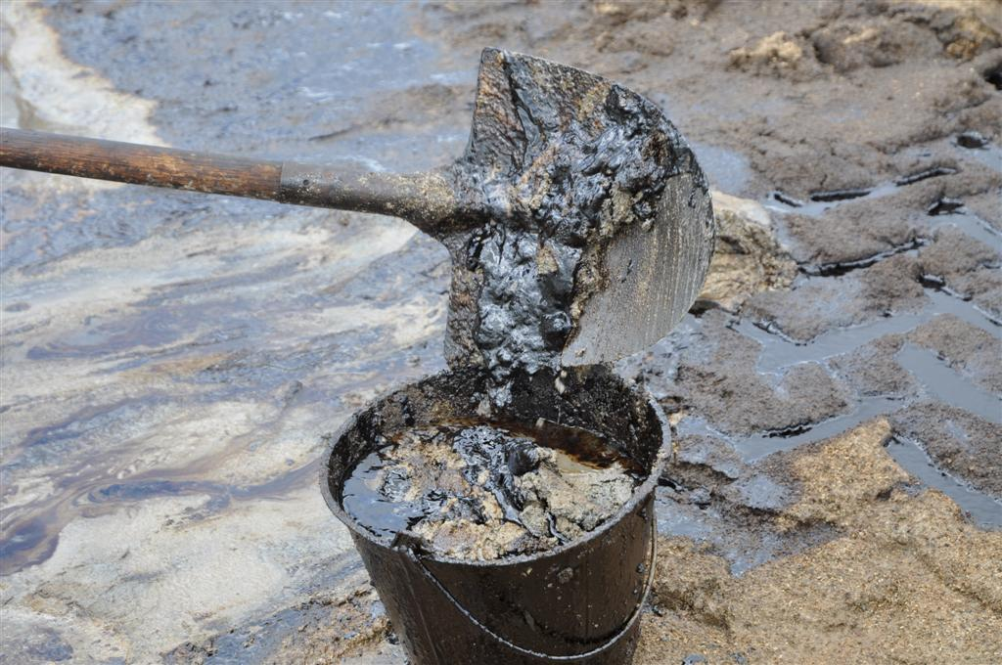
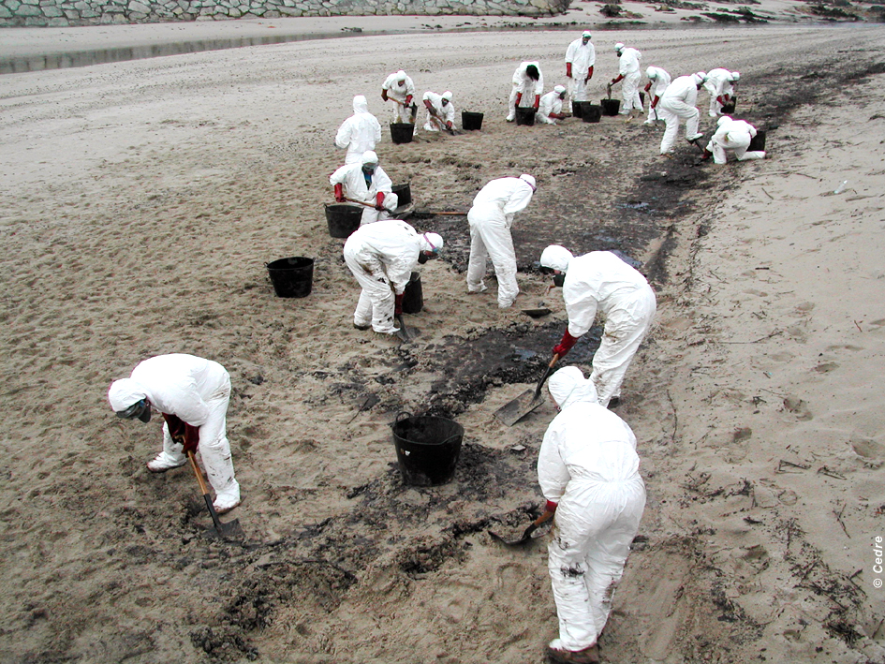
Manual Removal
Source: OSRL
Source: CEDRE
CGPRT(W) : Ensuring Clean Seas and Coasts in Western Region ……

Slide 24
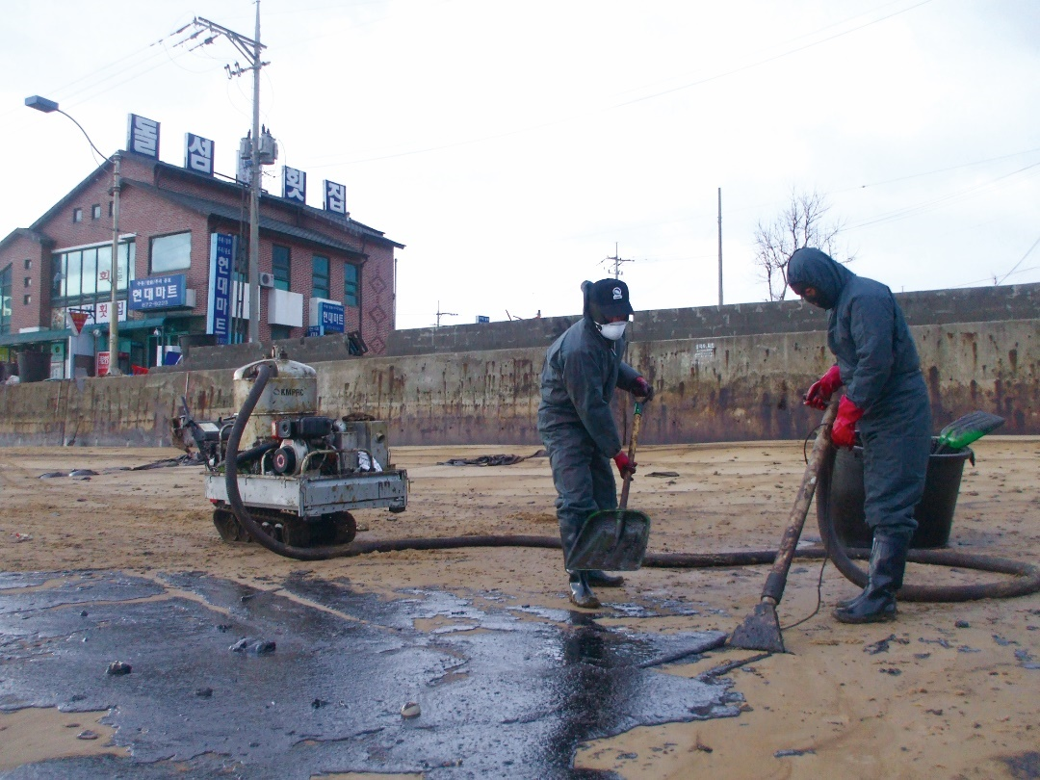
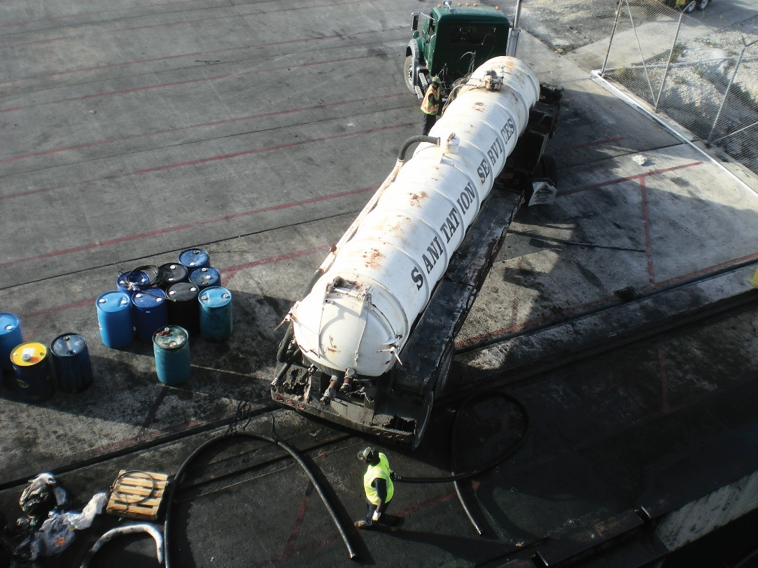
Vacuum Systems
Source: Korea Coast Guard
Source: OSRL
CGPRT(W) : Ensuring Clean Seas and Coasts in Western Region ……

Slide 25
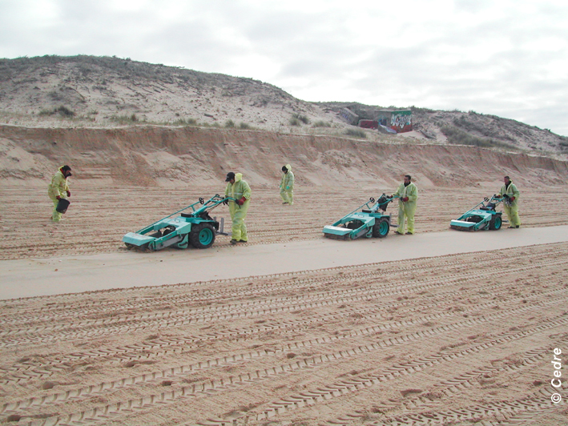
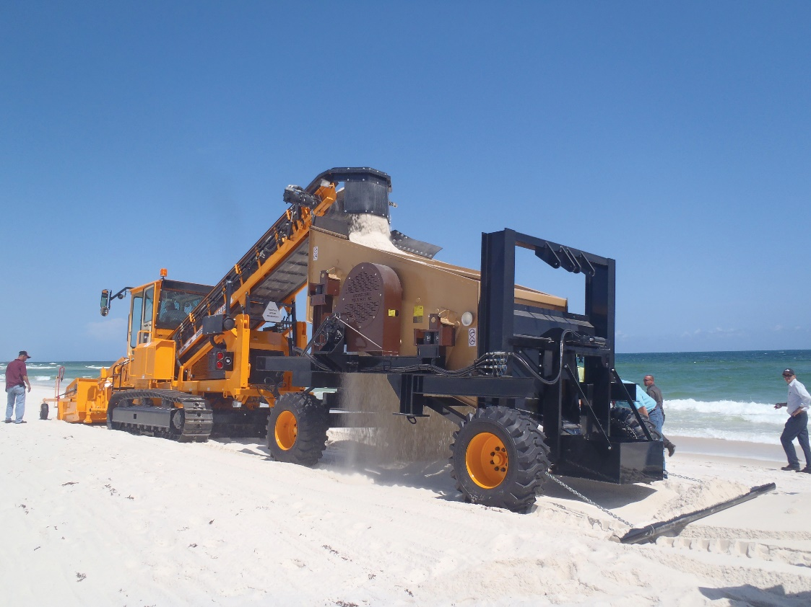
Mechanical Removal
Source: CEDRE
Source: OSRL
CGPRT(W) : Ensuring Clean Seas and Coasts in Western Region ……

Slide 26
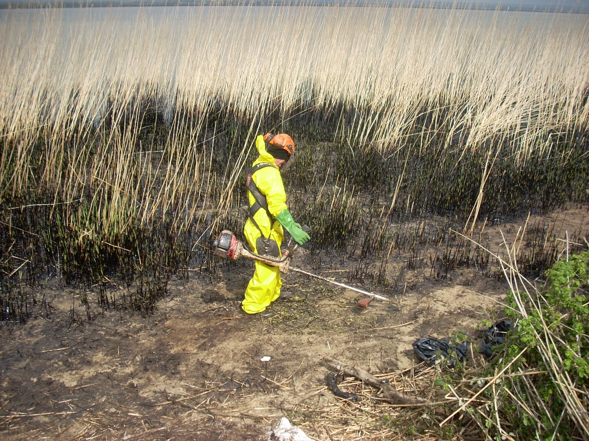
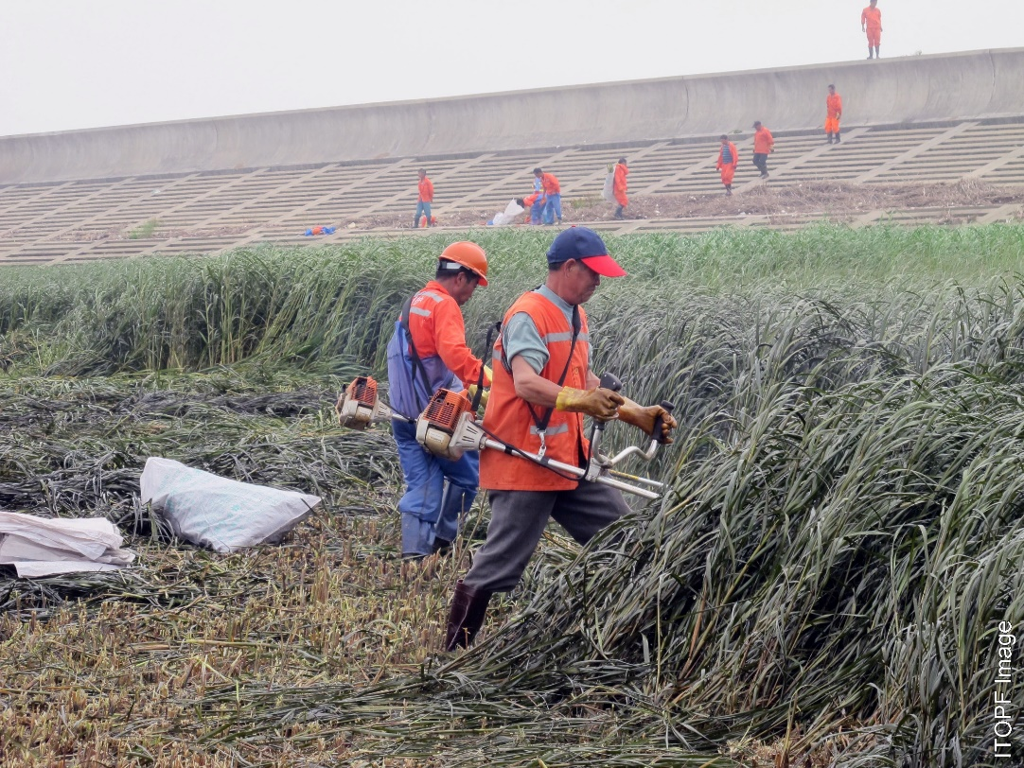
Vegetation Cutting
Source: CEDRE
Source: ITOPF
CGPRT(W) : Ensuring Clean Seas and Coasts in Western Region ……

Slide 27
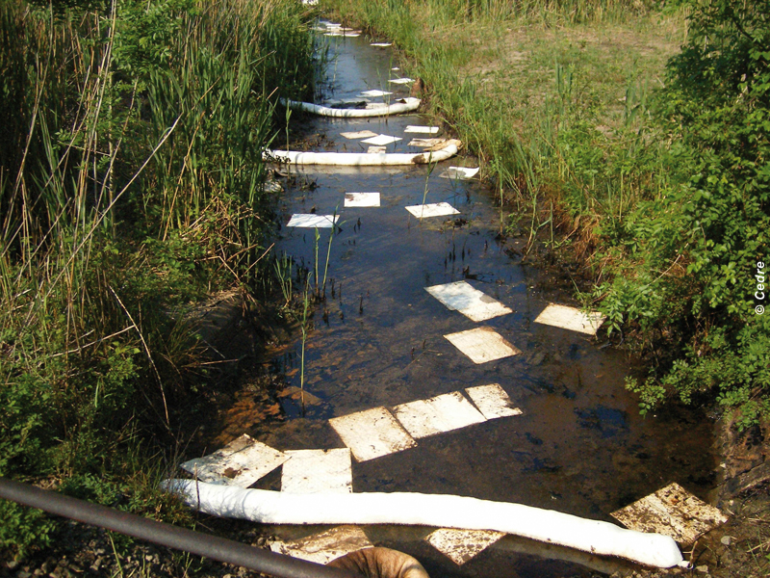
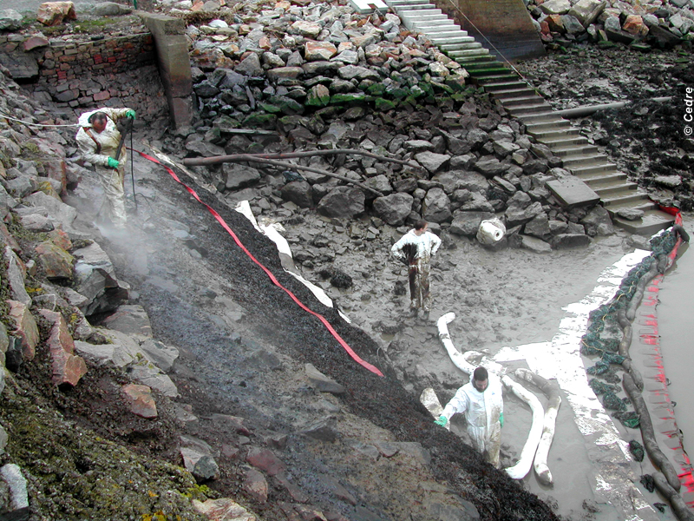
Sorbents
Source: CEDRE
Source: CEDRE
CGPRT(W) : Ensuring Clean Seas and Coasts in Western Region ……

Slide 28
Technique | Objective | Optimum use
Manual removal | Remove oil or oiled material (including oiled snow/ice) with manual labour and hand tool | Most shoreline types Small amounts of surface oil
Vacuum systems | Remove oil by suction from areas where it has pooled or collected in sumps | Light to medium, non-volatile, pooled or collected oil
Mechanical removal | Remove oil and oiled materials using mechanical equipment | Most fine to coarse-sediment beaches Large volumes of medium, heavy or solid oil
Vegetation cutting | Remove oiled stems to prevent remobilization of the oil or contact by animals and birds, or to accelerate the recovery of the plant. | Marshes, vegetated shorelines Where remobilization of oil will affect other resources.
Passive sorbents | Place sorbents in a fixed location(s) so that they pick up oil by contact | Any shoreline type Light to heavy, non-solid, non-volatile oils
CGPRT(W) : Ensuring Clean Seas and Coasts in Western Region ……

Slide 29
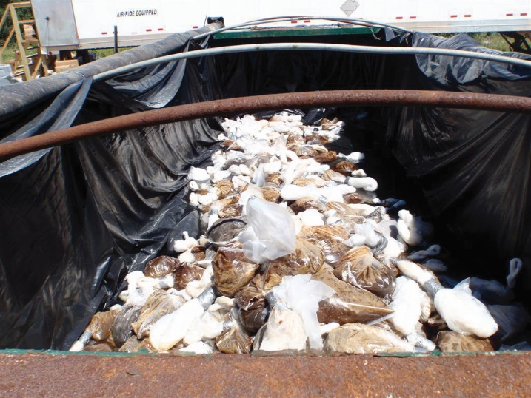
Operational Considerations
Oily waste and debris removal
Minimize sediment removal
Source: OSRL
CGPRT(W) : Ensuring Clean Seas and Coasts in Western Region ……

Slide 30
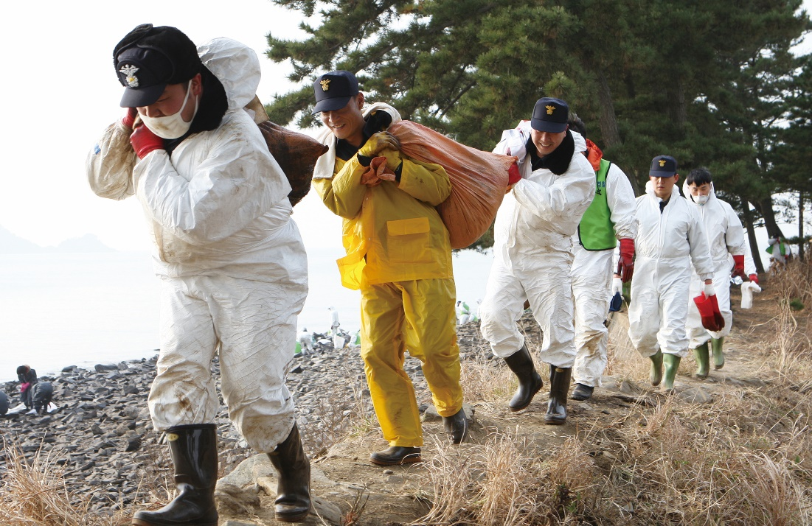
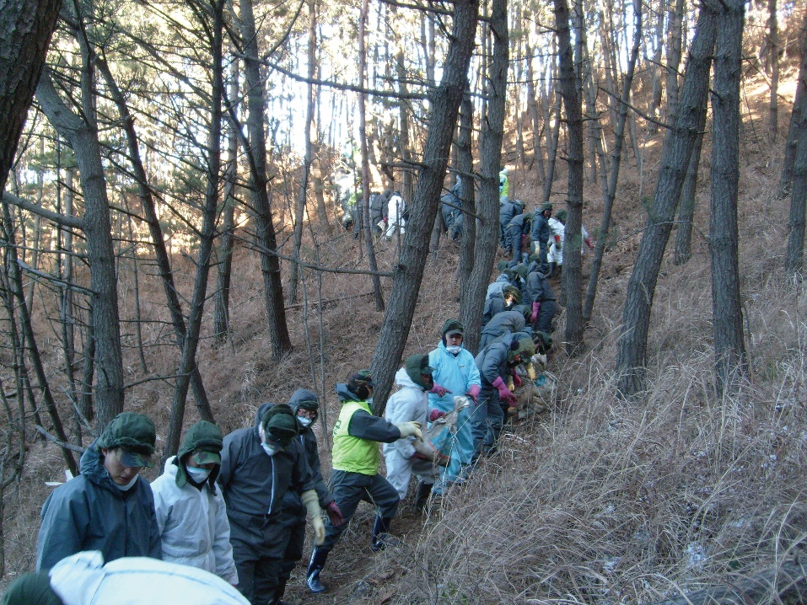
Operational Considerations
Traffic control:
Can damage dunes, or other shorelines
Can cause secondary contamination
Minimize impact of personnel and vehicles on shorelines
Source: Korea Coast Guard
Source: Korea Coast Guard
CGPRT(W) : Ensuring Clean Seas and Coasts in Western Region ……

Slide 31
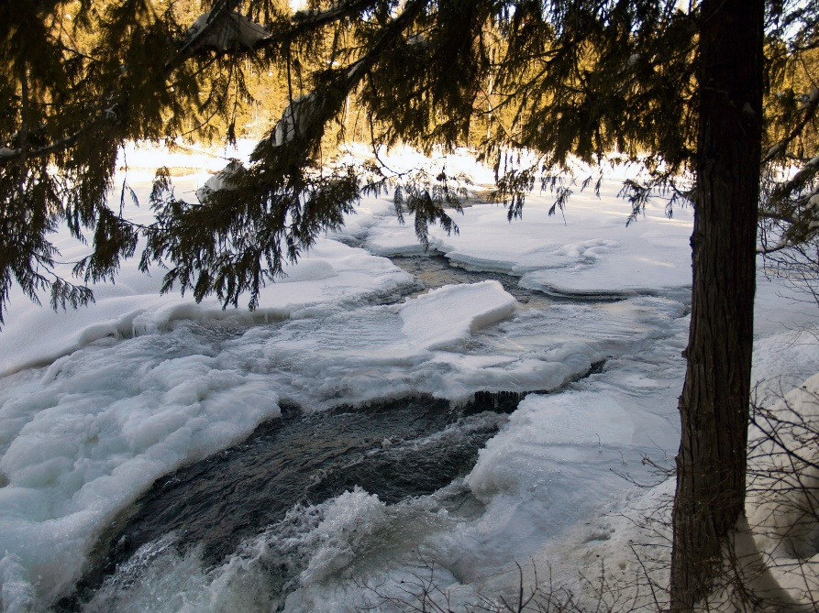
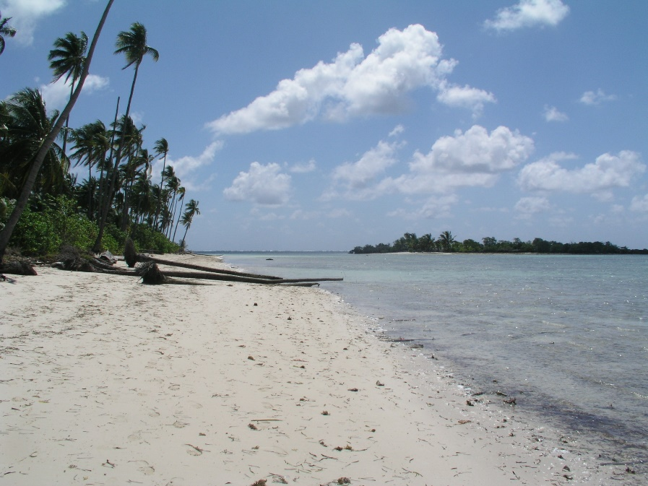
Operational Considerations
Winter and summer conditions:
Affects equipment operation (freezing/overheating)
Health and safety of personnel from environmental hazards
Source: OSRL
Source: OSRL
CGPRT(W) : Ensuring Clean Seas and Coasts in Western Region ……

Slide 32
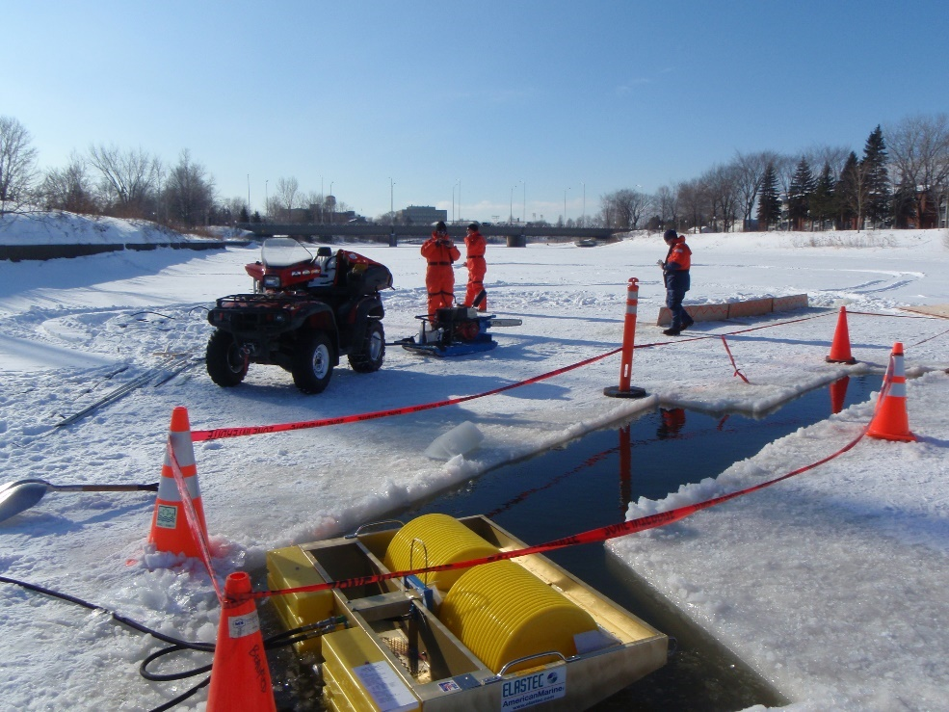
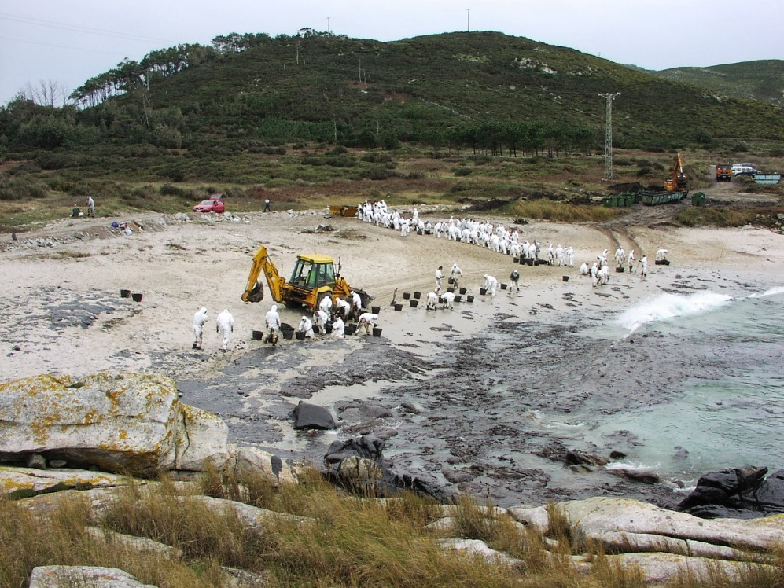
Operational Considerations
Load-bearing capacity
Shoreline must support equipment/personnel
Source: OSRL
CGPRT(W) : Ensuring Clean Seas and Coasts in Western Region ……

Slide 33
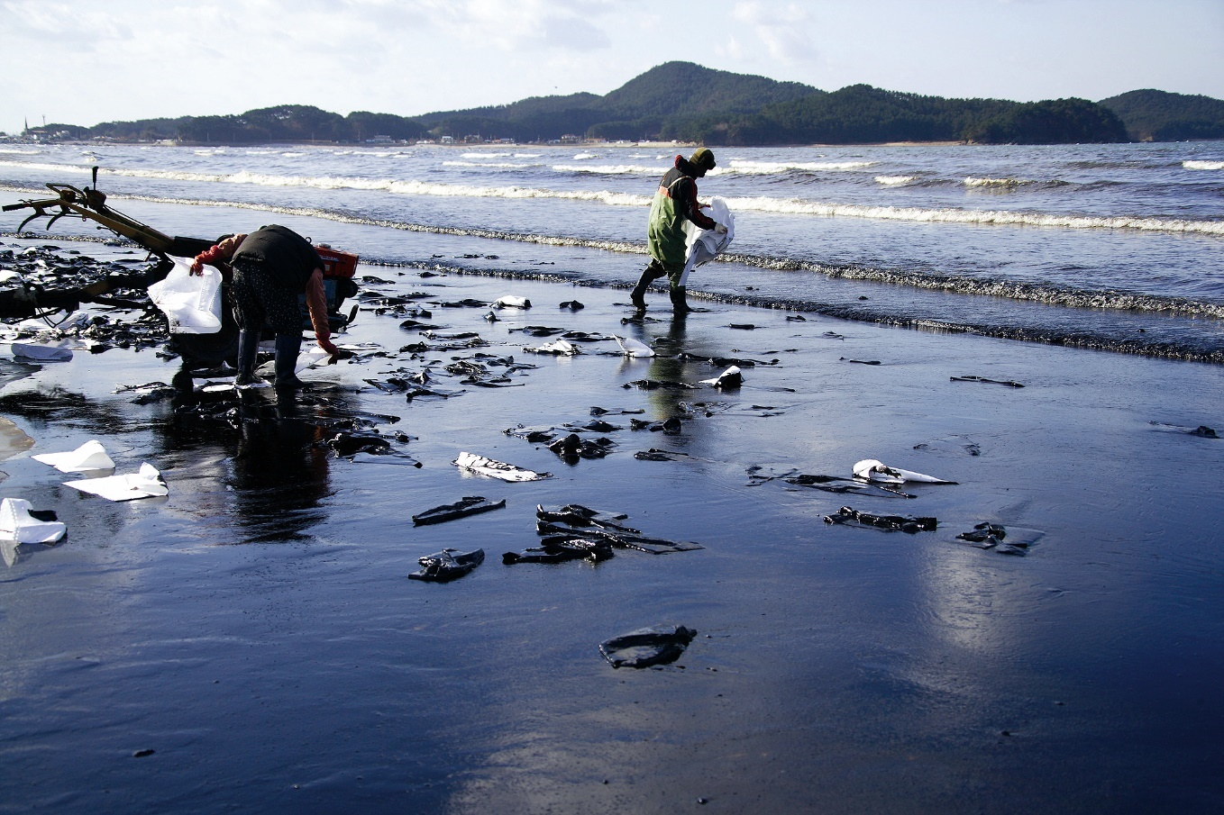
Operational Considerations
Contain and collect sorbents:
Sorbents must be contained and collected when saturated
Source: Korea Coast Guard
CGPRT(W) : Ensuring Clean Seas and Coasts in Western Region ……

Slide 34
Physical Response Methods : In-situ Treatment
On-site treatment techniques to promote or increase weathering and natural degradation in situ.
Mechanical tilling
Sediment reworking/Surf washing
Burning
CGPRT(W) : Ensuring Clean Seas and Coasts in Western Region ……

Slide 35
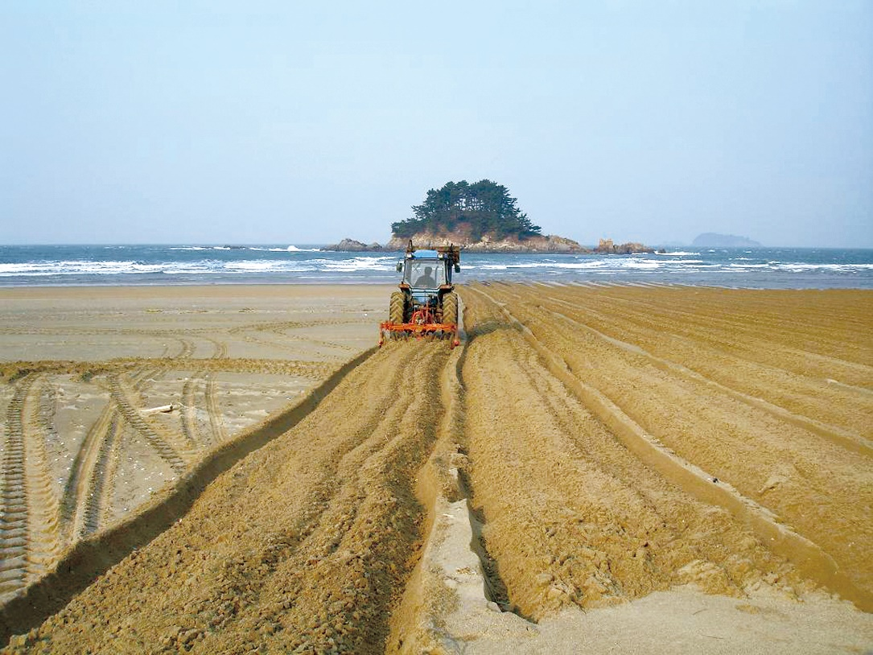
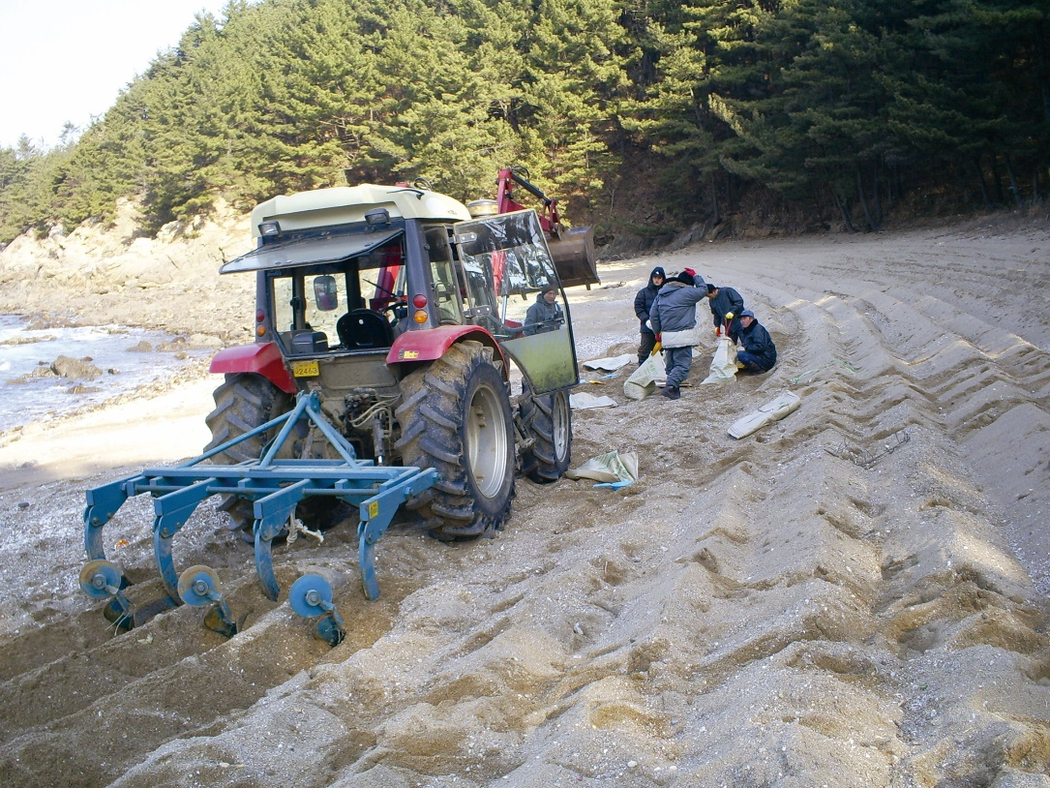
Mechanical Tilling
Source: Korea Coast Guard
Source: Korea Coast Guard
CGPRT(W) : Ensuring Clean Seas and Coasts in Western Region ……

Slide 36
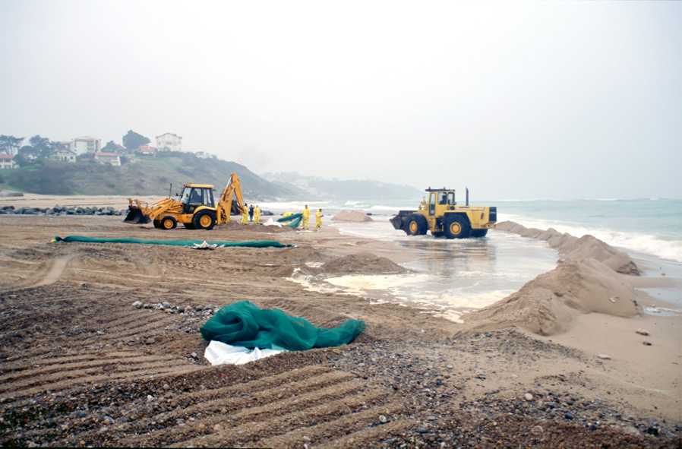
Sediment Reworking/Surf Washing
Source: CEDRE
CGPRT(W) : Ensuring Clean Seas and Coasts in Western Region ……

Slide 37
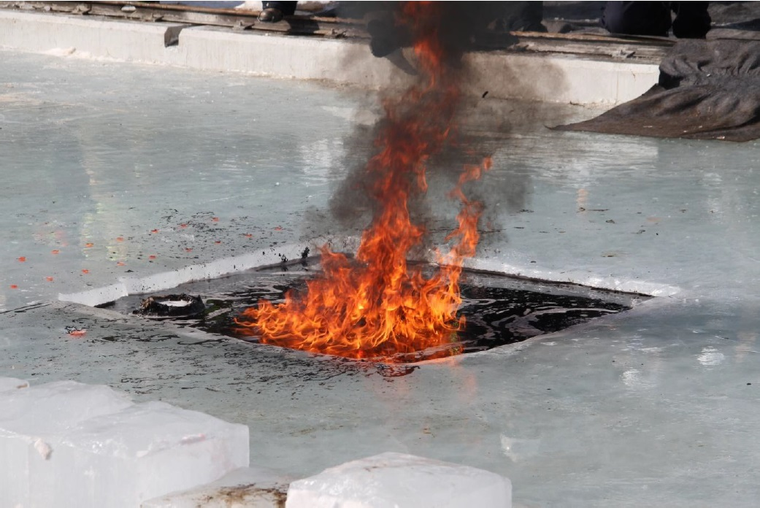
Burning
Source: OSRL
CGPRT(W) : Ensuring Clean Seas and Coasts in Western Region ……

Slide 38
Operational Considerations
Bearing capacity of substrate
Permit requirements
Level of oiling – tilling and surf washing are not used until gross oil has been removed.
Burning has additional health and safety issues.
CGPRT(W) : Ensuring Clean Seas and Coasts in Western Region ……

Slide 39
Physical Response Methods: Chemical/Biological
This group includes:
Shoreline cleaners
Solidifiers
Nutrient enrichment/Bioremediation
Facilitate removal of the oil from the shore zone.
Accelerate in situ weathering.
CGPRT(W) : Ensuring Clean Seas and Coasts in Western Region ……

Slide 40
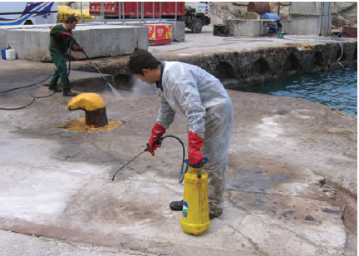
Shoreline Cleaning Agents
Source: ITOPF
CGPRT(W) : Ensuring Clean Seas and Coasts in Western Region ……

Slide 41
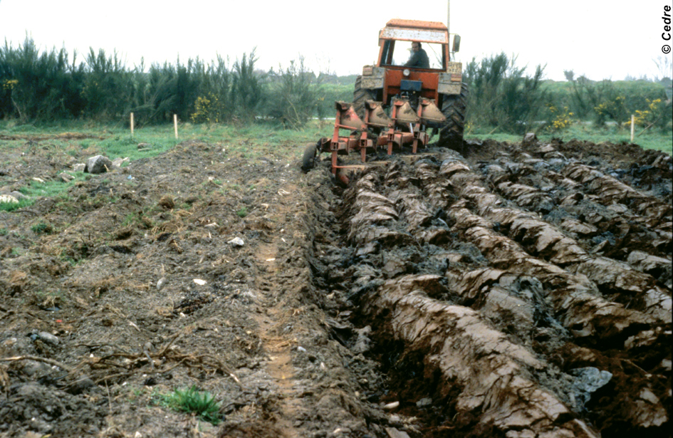
Bioremediation
Source: CEDRE
CGPRT(W) : Ensuring Clean Seas and Coasts in Western Region ……

Slide 42
Operational Considerations
Additional PPE may be required during application.
No application of shoreline cleaners on sensitive substrates
Products and procedures must be approved
Targeted application
Use minimal quantities
Prevent wash water from entering water courses
Must use containment for shoreline cleaning agents/solidifiers.
CGPRT(W) : Ensuring Clean Seas and Coasts in Western Region ……

Slide 43
Clean up Techniques by Shoreline Type
Man-made structures
Rocks and boulders
Cobbles, pebbles, shingle
Sand beaches
Muddy shores
CGPRT(W) : Ensuring Clean Seas and Coasts in Western Region ……

Slide 44
Manmade Structures
 | Accessible | Inaccessible
Stage 1 | Skimmers/pumps Vacuum trucks Flushing | Manual Manual and sorbents
Stage 2 | Pressure washing Passive cleaning Dismantle (rarely) Natural cleaning | Natural cleaning Hand wiping
Stage 3 | Hand wiping Natural cleaning | Natural cleaning
CGPRT(W) : Ensuring Clean Seas and Coasts in Western Region ……

Slide 45
Rock and Boulders
 | Accessible | Inaccessible
Stage 1 | Skimmers/pumps Vacuum trucks Flushing | Manual Manual and sorbents
Stage 2 | Pressure washing Sorbent materials Natural cleaning | Natural cleaning Hand wiping
Stage 3 | Natural cleaning Pressure washing Sand blasting (rarely) | Natural cleaning
CGPRT(W) : Ensuring Clean Seas and Coasts in Western Region ……

Slide 46
Cobbles, Pebbles and Shingle
 | Accessible | Inaccessible
Stage 1 | Skimmers/pumps Vacuum trucks Flushing | Manual Manual and sorbents
Stage 2 | Flushing Surf/cobble washing Mechanical Natural cleaning | Natural cleaning Hand wiping
Stage 3 | Natural cleaning Surf/cobble washing Sand blasting (rarely) | Natural cleaning
CGPRT(W) : Ensuring Clean Seas and Coasts in Western Region ……

Slide 47
Sand Beaches
 | Accessible | Inaccessible
Stage 1 | Skimmers/pumps Vacuum trucks Manual/mechanical Trenching Flushing | Manual Manual and sorbents
Stage 2 | Flushing Surf/cobble washing Mechanical | Natural cleaning Manual
Stage 3 | Natural cleaning Surf washing Ploughing/tilling Beach cleaning machines Sand sieving | Natural cleaning
CGPRT(W) : Ensuring Clean Seas and Coasts in Western Region ……

Slide 48
Muddy Shores
 | Accessible | Inaccessible
Stage 1 | Skimmers/pumps Vacuum trucks Flushing | Manual Manual and sorbents
Stage 2 | Flushing Manual | Natural cleaning Manual
Stage 3 | Natural cleaning | Natural cleaning
CGPRT(W) : Ensuring Clean Seas and Coasts in Western Region ……

Slide 49
Saltmarshes/Mangroves
General considerations
Difficult to access
Possible options: inside
Natural recovery
Low-pressure washing
Drainage and pumping
Vegetation cutting
Manual collection
Possible option: in front and at sea
Protection booms and sorbents
Natural recovery
CGPRT(W) : Ensuring Clean Seas and Coasts in Western Region ……

Slide 50
Subsurface Oil
Oil may become buried in a variety of ways
seaweed
Wind-blown sand
sand dune collapse during storm events
mobile sediment due to wave action/tides
permeates shoreline sediment
CGPRT(W) : Ensuring Clean Seas and Coasts in Western Region ……

Slide 51
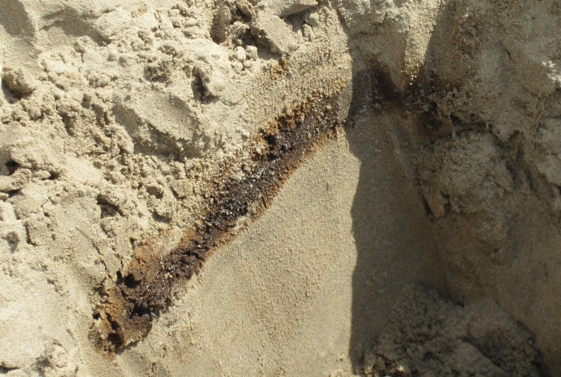
Subsurface Oil
Locating and delineating subsurface oil
pits in transects at right angles to shoreline
trenches
dogs
core samples
local knowledge and scientific expertise
Source: OSRL
CGPRT(W) : Ensuring Clean Seas and Coasts in Western Region ……

Slide 52
Conclusion
Safety is always the first priority.
The selection and correct application of clean-up techniques are essential.
The methods will be based on oil quantity and characteristics, on-site conditions and shoreline type.
Shoreline workers must understand their role and task and work together safely.
Expert advice should be sought prior to undertaking treatment.
CGPRT(W) : Ensuring Clean Seas and Coasts in Western Region ……

Slide 53
Any questions?
CGPRT(W) : Ensuring Clean Seas and Coasts in Western Region ……

